Slide 1

Typing of Characters on LCD Screen Interfaced with LPC2129 using IR Remote and Receiver
Prepared by: Vishal Mesta & Jayanth Thupili

Slide 2
INTRODUCTION
The project aims to explore the capabilities of interfacing an LPC2129 microcontroller with an IR remote and receiver to enable typing of characters on an LCD screen. By decoding the 32-bit NEC code generated by the IR remote, the microcontroller can interpret user inputs and display the corresponding characters on the LCD screen.
User Interaction: Users can conveniently input commands or data through the IR remote, which are then displayed on the LCD screen. This enhances the user experience and provides an intuitive interface.
Remote Control Functionality: By incorporating an IR remote and receiver, the system allows for remote control capabilities. Users can operate the system from a distance without the need for physical contact or direct access to the microcontroller or LCD screen. This is particularly useful in scenarios where the system is mounted in inaccessible or hazardous locations.
Embedded Systems Development: The interfacing of microcontrollers with external peripherals, such as LCD screens and IR receivers, is a fundamental aspect of embedded systems development. By working on such projects, engineers gain valuable experience in integrating hardware components, programming interfaces, and developing user-friendly applications.

Slide 3
PROJECT OVERVIEW
The project involves interfacing an LPC2129 microcontroller with an IR receiver and decoding the 32-bit NEC code generated when a key on the IR remote is pressed. This is achieved by connecting the output of the IR receiver to the LPC2129 pin configured as an input.
To decode the NEC code, Timer 0 is configured to measure various components of the IR signal, including the start of the frame, logic 0, logic 1, and repeat signal. The timer is reset at the start of a logic high pulse, and the value of the timer counter is recorded when the pulse changes to logic low. By measuring the duration of these pulses using Timer 0, the microcontroller can accurately determine important components of the IR signal.
The project also involves mapping specific keys on the IR remote to different functionalities. For example, certain keys may change the input type, such as switching between numeric and alphabetic characters. Other keys may be mapped to display multiple characters, cycling through them when the key is kept pressed. Some keys may alter the display style, allowing for static or scrolling character presentation.

Slide 4
All these functionalities are displayed on an LCD screen. The microcontroller communicates with the LCD screen to update and manipulate the displayed characters based on the decoded IR signals.
Overall, the project aims to enable users to type characters on the LCD screen using an IR remote, with the LPC2129 microcontroller handling the IR signal decoding, mapping of key functionalities, and control of the LCD display.

Slide 5
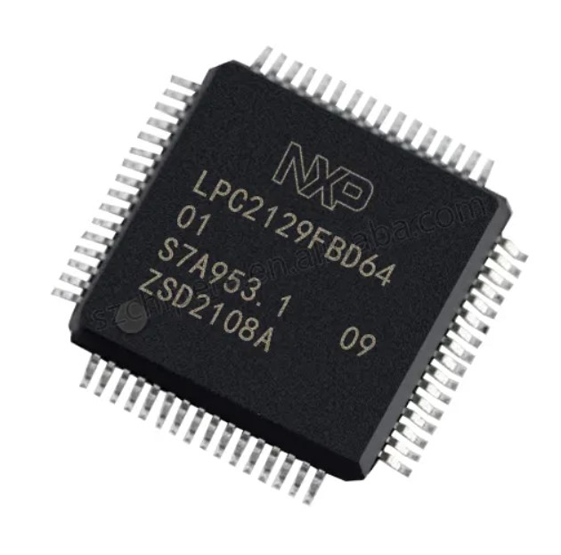
LPC2129 MICROCONTROLLER
ARM7TDMI-S Core: The LPC2129 is based on the ARM7TDMI-S architecture, offering a 16/32-bit RISC processor core.
High-Speed GPIO: It offers up to 48 general-purpose I/O (GPIO) pins, allowing for versatile interfacing with external devices and components.
On-Chip Memory: The LPC2129 includes 16KB of on-chip static RAM (SRAM) and 256KB of on-chip flash memory, offering ample storage for program code and data.
External Memory Interface: It supports an external memory interface for connecting additional RAM, flash, or other memory devices to expand the available storage capacity.
Multiple Communication Interfaces: The LPC2129 features multiple communication interfaces, including UART, SPI (Serial Peripheral Interface), and I2C (Inter-Integrated Circuit), enabling easy integration with various peripheral devices.

Slide 6
PWM and Timer Modules: It includes Pulse-Width Modulation (PWM) modules and timers, allowing for precise timing control and generation of PWM signals for applications such as motor control and analog signal generation.
Analog-to-Digital Converter (ADC): The LPC2129 integrates a 10-bit ADC with up to 4 channels, allowing for analog signal conversion and measurement
Vectored interrupt controller with configurable priorities and vector addresses.
Development Tools and Support: NXP provides a comprehensive development ecosystem, including software development tools, application libraries, and technical documentation, to facilitate the development and debugging of applications based on the LPC2129 microcontroller.

Slide 7
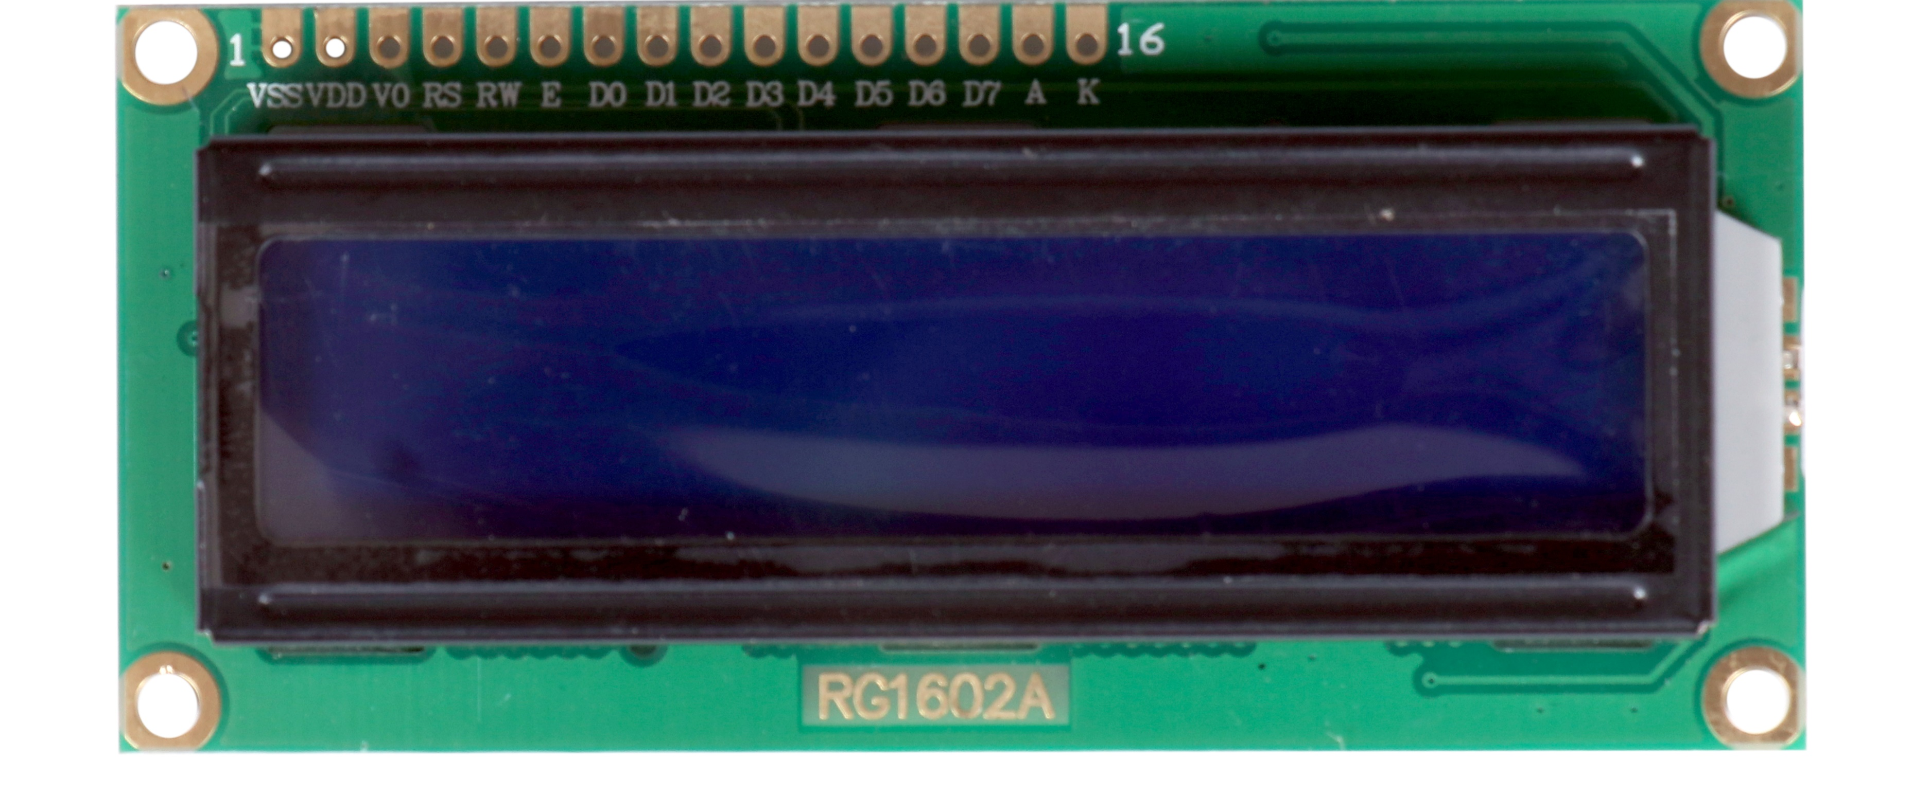
LCD SCREEN
Display Resolution: The RG1602 LCD module has a resolution of 16 columns and 2 rows, resulting in a total of 32 displayable characters.
Character Set: It typically supports a standard character set, such as the ASCII character set, allowing the display of alphanumeric characters, symbols, and special characters.
Controller Compatibility: The module is compatible with controllers like the HD44780 or equivalent, which provide essential functions for controlling the display, such as data and command transmission, character generation, and cursor control.
Communication Interface: The RG1602 LCD module utilizes a parallel interface for communication with external devices. It usually requires multiple data lines (typically 8 data lines in 8-bit mode or 4 data lines in 4-bit mode) for transmitting character and control data.

Slide 8
Instruction Set: The module follows a specific instruction set defined by the controller, enabling various operations such as clearing the display, positioning the cursor, and manipulating the display attributes.
Contrast Adjustment: The module incorporates a contrast adjustment mechanism to control the contrast level of the displayed characters. This adjustment is typically achieved using a potentiometer or a dedicated control pin.
Backlight Control: It may feature a separate backlight control pin or integrated backlight driver circuitry to control the brightness of the LED backlight. This allows users to adjust the backlight intensity or even turn it off when not required.
Power Requirements: The RG1602 LCD module typically operates at a voltage range of 3.0V to 5.0V, with a typical current consumption of a few milliamperes during normal operation.

Slide 9
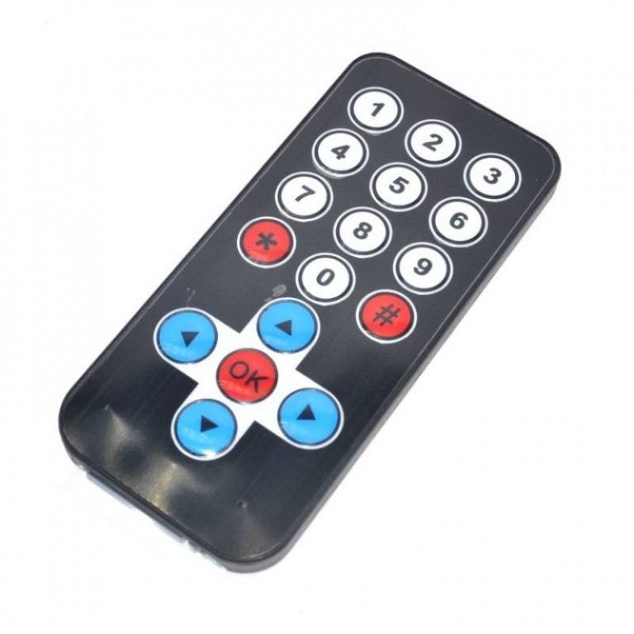
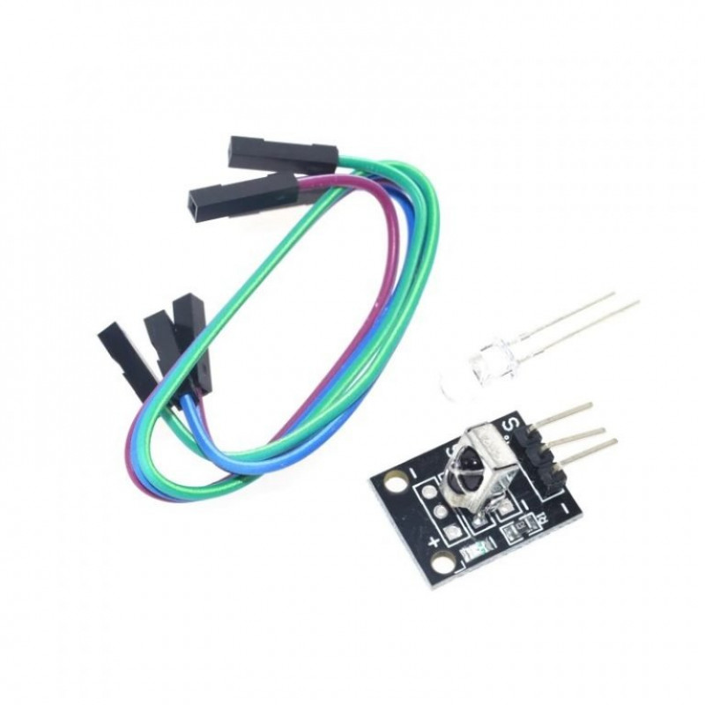
IR REMOTE AND RECEIVER
IR Remote:
The IR remote serves as the input device, allowing users to send commands wirelessly to the system.
The IR remote is a handheld device that emits infrared signals containing specific codes representing various commands. Each key press on the remote generates a distinct and unique signal, allowing for the differentiation of commands.
The IR remote used in this project follows the NEC IR protocol.
IR Receiver:
The IR receiver is a device that captures the infrared signals transmitted by the IR remote.
It converts the infrared signals into electrical signals that can be processed by the microcontroller.

Slide 10
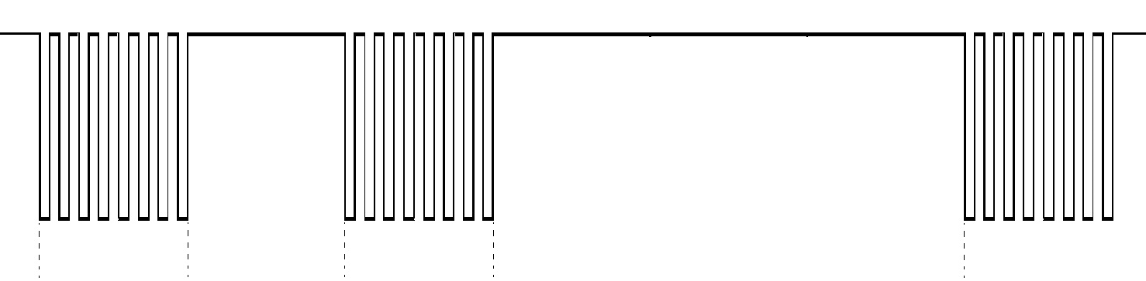
Communication Protocol: 32 bit NEC IR protocol uses a technique called pulse distance encoding to distinguish between the two logic states. The standard NEC protocol uses a carrier frequency of 38 kHz. The logic states are encoded by using pulses of different lengths to distinguish between HIGH and LOW.
Binary values are encoded as follows:
Logical 1: a 562.5 µs burst followed by a 1.6875 ms high period
Logical 0: a 562.5 µs burst followed by a 562.5 µs high period
562.5 µs
Burst
562.5 µs
Logic low
562.5 µs
Burst
1687.5 µs
Logic High
562.5 µs
Burst

Slide 11
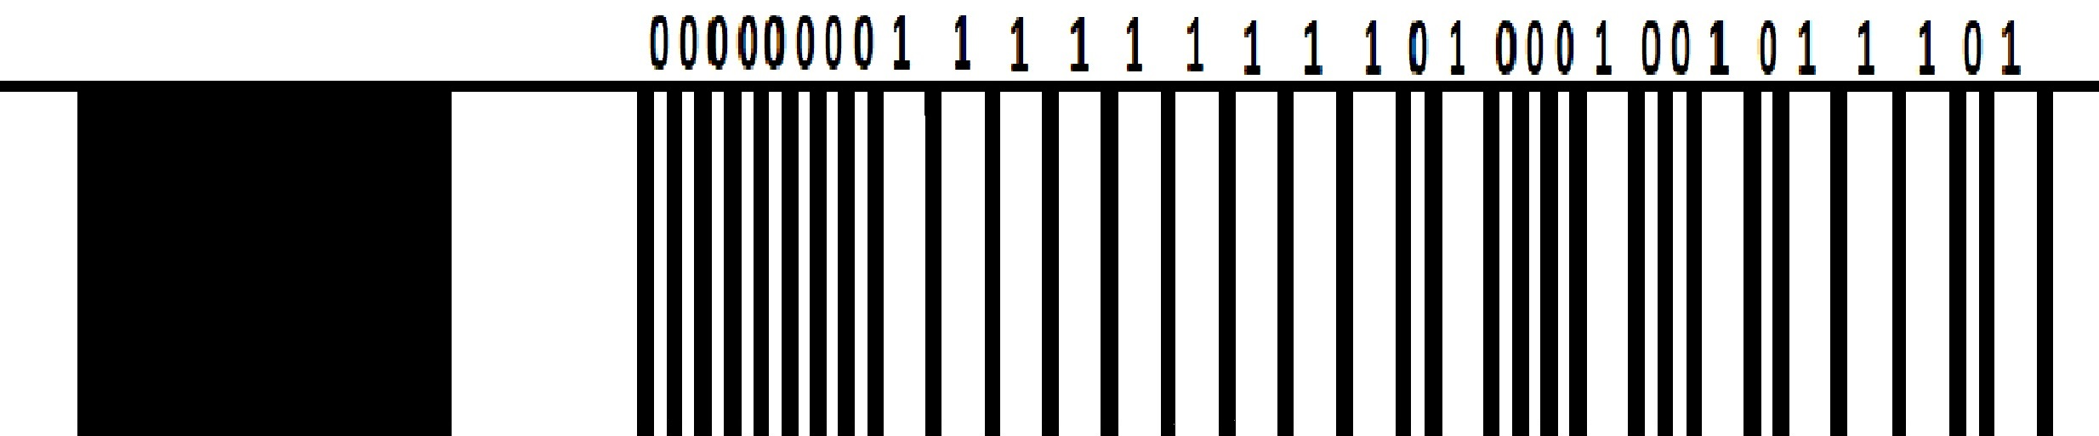
**pulse burst is illustrated in darker shade
A 9ms leading pulse burst (16 times the pulse burst length used for a logical data bit)
A 4.5ms space
The 8-bit address for the receiving device
The 8-bit logical inverse of the address
The 8-bit command
The 8-bit logical inverse of the command
4.5 ms High
9 ms burst
LSB
32 bit message
MSB
Message frame generated when button 1 of IR remote is pressed ( 0xBA45FF00 )

Slide 12

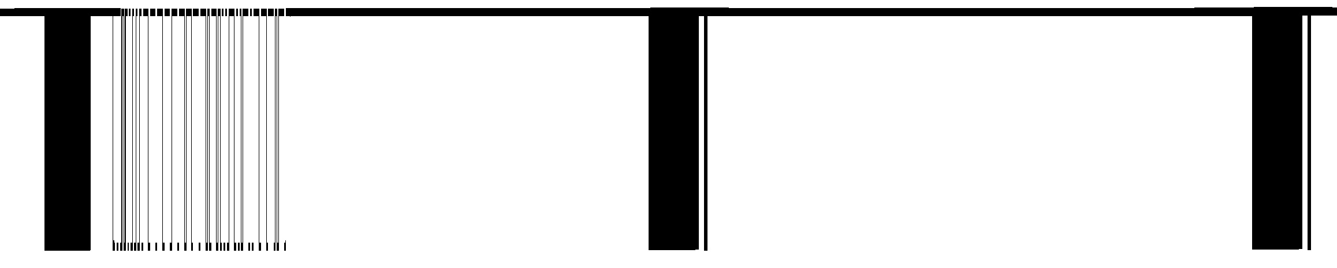
Repeat Codes
If the key on the remote controller is kept depressed, a repeat code will be issued, typically around 40ms after the pulse burst that signified the end of the message.
A repeat code will continue to be sent out at 108ms intervals, until the key is finally released.
A 9ms leading pulse burst A 2.25ms space A 562.5µs pulse burst to mark the end of the space (and hence end of the transmitted repeat code)
9 ms
Burst
2.25 ms
High
67.5 ms message
108 ms
108 ms
Repeat signal

Slide 13
NEC Features • 8-bit address and 8-bit command length. • Extended mode available, doubling the address size. • Address and command are transmitted twice for reliability. • Pulse distance modulation. • The carrier frequency of 38kHz. • Bit time of 1.125ms or 2.25ms

Slide 14

INTERFACING SCHEMATIC
5V
GND
**other connections to the µC are not shown as the project utilises development board
P1.17
S
GND
5V
Data lines connecting µC pins
P0.15 – P0.22 to LCD Pins D0 – D7
RS pin (LCD) connected to P0.10 (µC)
RW pin (LCD) connected to P0.12 (µC)
EN pin (LCD) connected to P0.13 (µC)

Slide 15
SOFTWARE DESIGN
IDE used for development of the project: Keil MicroVision Software
Programming Language: C
Program overview:
“lcd_fun.c" File: The project includes an "lcd_fun.c" file that contains the necessary LCD configuration and functions to display characters, numbers, and strings on the LCD screen.
Timer 0 Configuration: A Timer 0 configuration function has been implemented, where Timer 0 is set with a resolution of 1 microsecond and is reset after 1 second. The timer is enabled to facilitate accurate timing measurements.
'key_status' Function: The 'key_status' function is utilized to monitor instances of pressing the IR remote key. It continuously checks for key press events, decodes the signal from the IR receiver, and saves the 32-bit message signal in a user-defined unsigned int variable.
'Key_map' Function: The 'Key_map' function maps character(s) to the IR remote buttons. It determines the appropriate character or action based on the key pressed.

Slide 16
Main Function: In the main function, LCD and timer configuration functions are invoked to initialize and set up the LCD screen and Timer 0. This ensures proper functioning and synchronization of the hardware components.
Within the main function, the 'key_status' function is used to monitor instances of key presses. It continuously checks for key press events from the IR remote. Once a key press is detected, a switch case is utilized to handle different scenarios based on the mapped key. The switch case determines whether the key is mapped to a function key or a character key. If the key corresponds to a function key, such as changing the character display from alphabet to number, changing the case of the alphabet, or moving the cursor left or right, the respective actions are performed. If the key is a character key, the 'Key_map' function is invoked to determine the appropriate character to display on the screen.

Slide 17
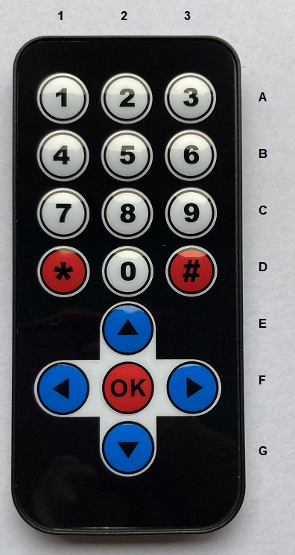
KEY | 32-BIT NEC IR CODE | MAPPED CHARACTER OR FUNCTION
1 | 0xBA45FF00 | Default: 1 . If ‘OK’ key is pressed, ‘A’. Cycling from ‘A’ through ‘C’ in a loop if key is kept depressed. Switches to lower case if ‘ ‘ is pressed.
2 | 0xB946FF00 | Default: 2 . If ‘OK’ key is pressed, ‘D’. Cycling from ‘D’ through ‘F’ in a loop if key is kept depressed. Switches to lower case if ‘ ‘ is pressed.
3 | 0xB847FF00 | Default: 3 . If ‘OK’ key is pressed, ‘G’. Cycling from ‘G’ through ‘I’ in a loop if key is kept depressed. Switches to lower case if ‘ ‘ is pressed.
4 | 0xBB44FF00 | Default: 4 . If ‘OK’ key is pressed, ‘J’. Cycling from ‘J’ through ‘L’ in a loop if key is kept depressed. Switches to lower case if ‘ ‘ is pressed.
5 | 0xBF40FF00 | Default: 5 . If ‘OK’ key is pressed, ‘M’. Cycling from ‘M’ through ‘O’ in a loop if key is kept depressed. Switches to lower case if ‘ ‘ is pressed.

Slide 18
KEY | 32-BIT NEC IR CODE | MAPPED CHARACTER OR FUNCTION
6 | 0xBC43FF00 | Default: 6 . If ‘OK’ key is pressed, ‘P. Cycling from ‘P’ through ‘R’ in a loop if key is kept depressed. Switches to lower case if ‘ ‘ is pressed.
7 | 0xF807FF00 | Default: 7 . If ‘OK’ key is pressed, ‘S’. Cycling from ‘S’ through ‘U’ in a loop if key is kept depressed. Switches to lower case if ‘ ‘ is pressed.
8 | 0xEA15FF00 | Default: 8 . If ‘OK’ key is pressed, ‘V’. Cycling from ‘V’ through ‘X’ in a loop if key is kept depressed. Switches to lower case if ‘ ‘ is pressed.
9 | 0xF609FF00 | Default: 9 . If ‘OK’ key is pressed, ‘Y’. Cycling from ‘Y’ through ‘Z’ in a loop if key is kept depressed. Switches to lower case if ‘ ‘ is pressed.
0 | 0xE619FF00 | Default: 0 . If ‘OK’ key is pressed ‘ ‘ .

Slide 19
KEY | 32-BIT NEC IR CODE | MAPPED CHARACTER OR FUNCTION
* | 0xE916FF00 | Default: * . Cycling from ‘*’ through ‘,’ in a loop if key is kept depressed.
# | 0xF20DFF00 | Default: # . Cycling from ‘#’ through ‘%’ in a loop if key is kept depressed.
OK | 0xE31CFF00 | switches between displaying an alphabet and a number on the screen
 | 0xE718FF00 | Upper Case Alphabets
 | 0xAD52FF00 | Lower Case Alphabets
 | 0xF708FF00 | Move Cursor Left
 | 0xA55AFF00 | Move Cursor Right

Slide 20
RESULTS AND DEMONSTRATION

Slide 21
CONCLUSION
The primary objective of this project was to decode the NEC IR code using the LPC2129 microcontroller and map the functionality to read the signal corresponding to each button of the IR remote.
The key features implemented include the decoding of the IR code and mapping of characters and functions to each key on the IR remote.
The project showcases the capabilities of the LPC2129 microcontroller, IR remote, and LCD screen in creating an interactive user interface.
The potential application of the project extends to controlling external devices. The decoded signal can be mapped to actions such as turning on or off a motor, setting the angle of a stepper motor, or controlling other external devices.
Throughout the development process, the main challenges were understanding the NEC IR code protocol and implementing the mapping of functions to the IR remote keys. These challenges were successfully addressed through thorough research and experimentation.

Slide 22
REFERENCES
LPC2129 datasheet
https://exploreembedded.com/wiki/NEC_IR_Remote_Control_Interface_with_8051 for understanding of NEC IR protocol and logic for decoding output of IR receiver.
Internet surfing

